Slide 1

GraphInsights
An Interactive Graph Dashboard for Network Topology
& Centrality Analysis
Michael Fernandes - 2509006
Manav Williams - 2509037
Anshul Shashidhar- 2509012
PSBDA6005CR1PR
Notes:
1

Slide 2
Introduction
1. The World We Live In
2. The Problem Statement
Networks are everywhere — from social media and the internet to power grids and brain connections. Understanding them is critical.
Most network analysis happens in static environments. It's nearly impossible to 'see' how changing one parameter ripples through a whole system.
3. Our Goal
4. What We Learn from this Project
Build a real-time interactive tool that lets users experiment with graph mathematics visually, lowering the barrier to learning complex theory.
How different growth models — Random vs. Scale-free vs. Small-world — change the structural 'heartbeat' of a network.
Notes:
2

Slide 3
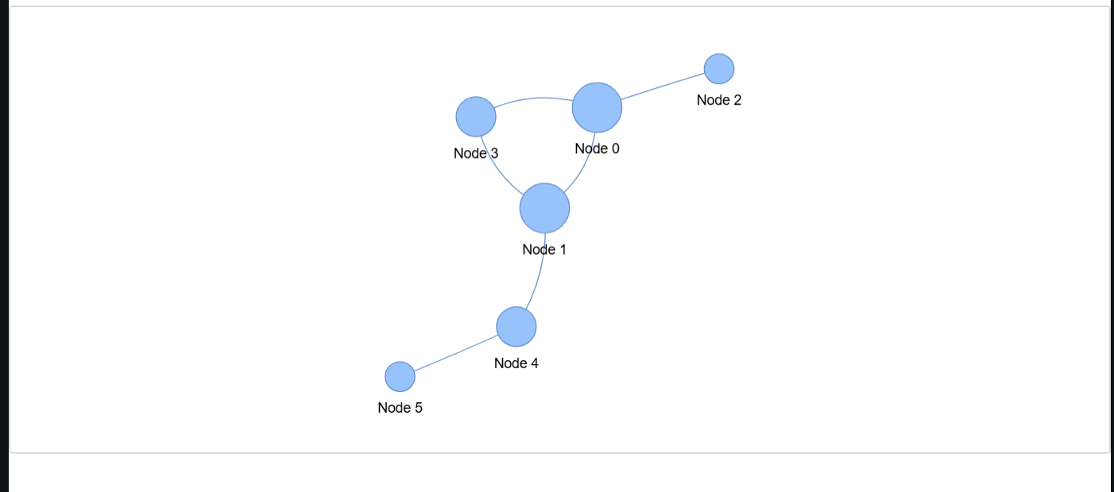
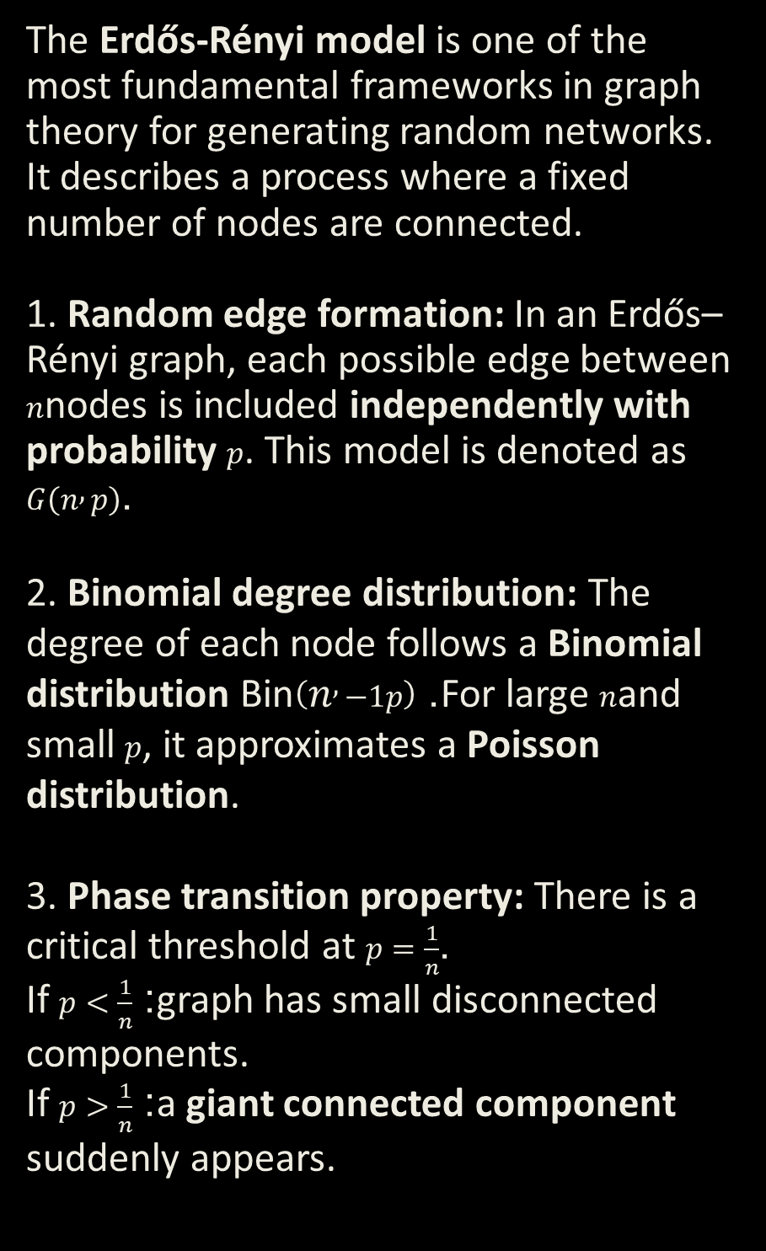
Network Topologies- Erdős-Rényi
The Erdős-Rényi model is one of the most fundamental frameworks in graph theory for generating random networks. It describes a process where a fixed number of nodes are connected.
1. Random edge formation: In an Erdős–Rényi graph, each possible edge between $n$nodes is included independently with probability $p$. This model is denoted as $G\left(n , p\right)$.
2. Binomial degree distribution: The degree of each node follows a Binomial distribution $\text{Bin}\left(n , −1p\right)$. For large $n$and small $p$, it approximates a Poisson distribution.
3. Phase transition property: There is a critical threshold at $p=\frac{1}{n}$.
If $p<\frac{1}{n}$: graph has small disconnected components.
If $p>\frac{1}{n}$: a giant connected component suddenly appears.
Notes:
3

Slide 4
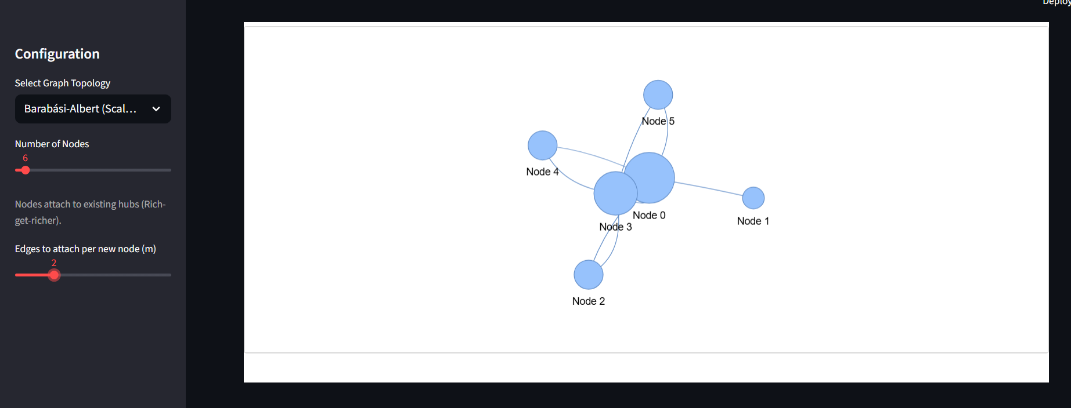
Network Topologies-Barabási-Albert
The Barabási–Albert model is a random network model that generates scale-free networks using two key principles: growth (nodes are added over time) and preferential attachment (new nodes are more likely to connect to already highly connected nodes).
1. Growth mechanism: The network starts with a small set of nodes, and new nodes are added one at a time.
2. Preferential attachment: New nodes connect to existing nodes with probability proportional to their degree (“rich get richer” effect).
3. Scale-free property: The degree distribution follows a power law, meaning a few nodes become hubs with very high degree.
Notes:
3

Slide 5
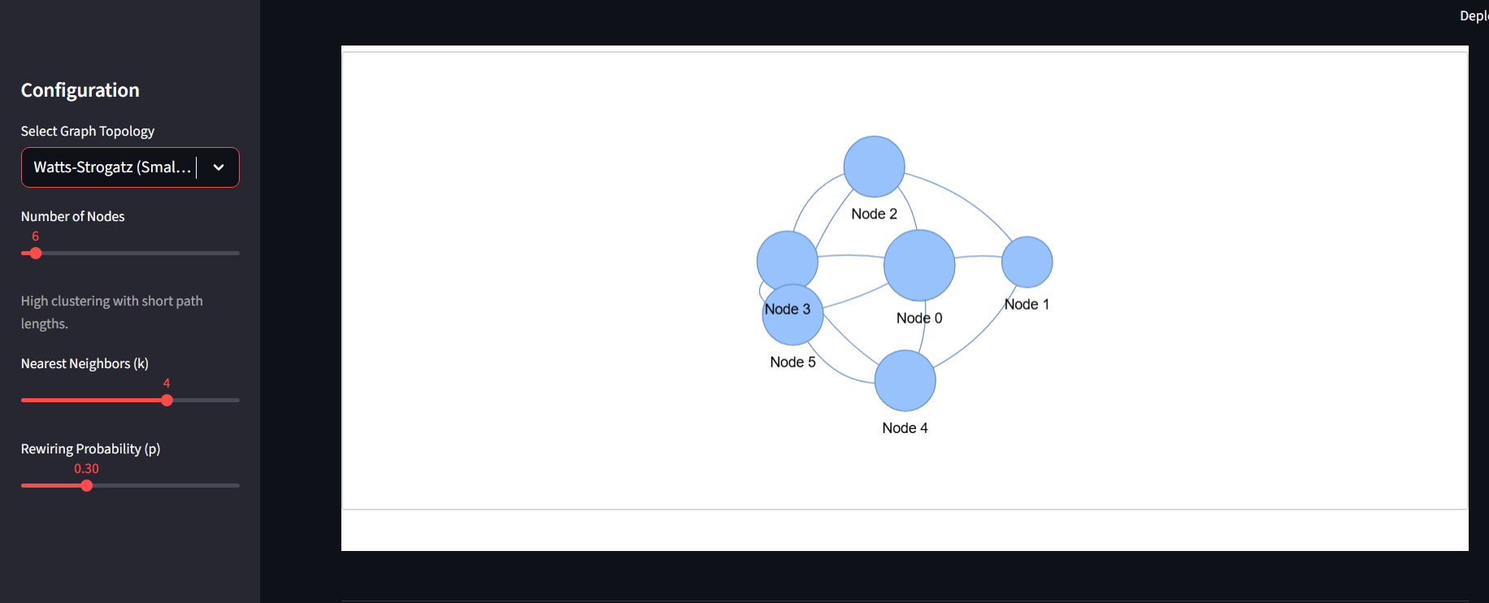
Network Topologies-Watts-Strogatz
1
The Watts–Strogatz model is a network model that generates small-world networks by starting with a regular lattice and randomly rewiring some edges with probability ppp. It captures both high clustering and short average path length, properties seen in many real-world networks.
Regular lattice start: Begin with nodes arranged in a ring where each node is connected to its kkk nearest neighbors.
Random rewiring: Each edge is rewired with probability ppp, introducing randomness into the network.
Small-world property: Produces short average path lengths similar to random graphs
High clustering: Maintains a high clustering coefficient, unlike Erdős–Rényi graphs.
Erdős-Rényi
Random Graph
Nodes connect by pure chance with a fixed probability p. Edges are uniformly distributed — no hubs, no hierarchy.
Equal Probability
Notes:
3

Slide 6
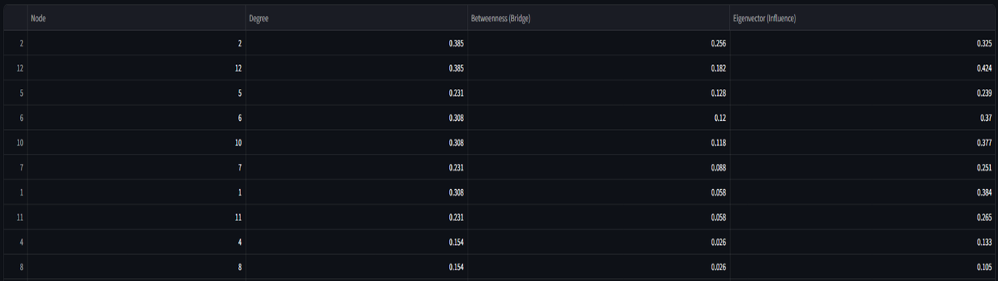
Deep Dive: Centrality Measures
Defining 'Influence' in our Dashboard — three lenses to measure node importance
Counts the total number of direct connections (edges) a node has. The simplest measure of local popularity. In the dashboard, a higher degree = larger visual node size.
1.Degree Centrality
"How many friends?"
Measures how often a node lies on the shortest path between two other nodes. High betweenness = a critical bridge or gatekeeper. Remove it and the network may fracture.
2.Betweenness Centrality
"Who controls information flow?"
Prestige-based influence. A node scores high not just by having many connections, but by being connected to other highly central nodes. This is the logic behind Google's PageRank.
3.Eigenvector Centrality
"Who knows the important people?"
Notes:
4

Slide 7
Technology Stack
1. Python
Python is a high-level, general-purpose programming language known for its simple, readable syntax that prioritizes developer productivity across diverse fields like web development, data science, AI, and automation
Core Language
2. Pandas
Pandas is primarily used to process and clean tabular datasets
Creating Dataframe
3. Streamlit
Powers the sidebar controls, layout, and reactive UI. Users interact with sliders and dropdowns that instantly regenerate the entire graph.
Frontend Framework
4. Pyvis
Force-directed physics engine rendering the Interactive Network section. Nodes repel naturally to avoid any overlaps.
Network Visualization
5. Plotly Express
Renders the degree distribution bar charts, centrality correlation scatter plots, and the Node Popularity donut chart.
Analytics Charts
6. NetworkX
Python library that computes all centrality measures, community detection, shortest paths, and connectivity checks.
Graph Mathematics
Notes:
5

Slide 8
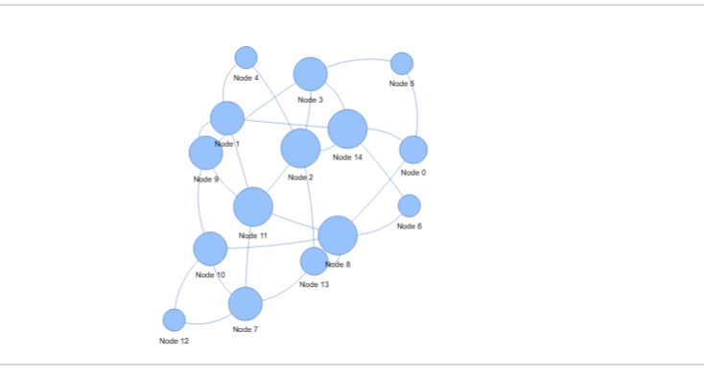
Interactive Network
1. Drag & Explore
Users can drag individual nodes, zoom in/out, and hover to see node metadata in real-time.
2. Visual Encoding
Node size is proportional to its Degree centrality — hubs are visually prominent at a glance.
3. Physics Engine
Pyvis applies repulsion forces so nodes spread naturally, preventing 'hairball' overlap.
4. User Input
You Can Assign the Type OF Graph, Number of Nodes and Edge Probability
Notes:
6

Slide 9
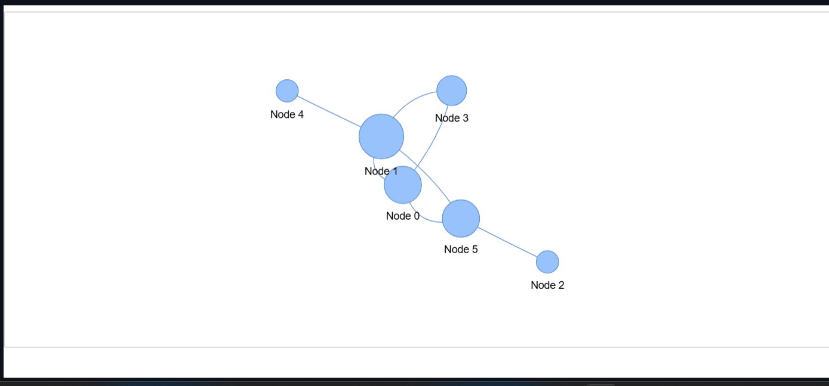
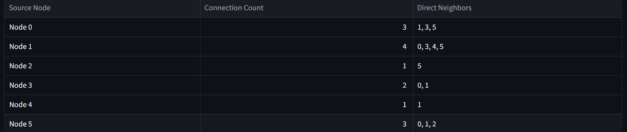
Connectivity Analytics
1. Total Nodes: 6
2. Average Connections: 2.33
3. Most Connected : 4 Edges
4. Least Connected: 1 Edge
Notes:
7

Slide 10

Real-World Application: Linkedin Network Influence
1. The Degree Fallacy
A recruiter doesn't necessarily need the most connections (Degree). Having 500+ connections to people in the same industry is less valuable than being the bridge between industries.
2. Scale-Free Reality
Real social networks are NOT random. They follow the Barabási-Albert model: a few 'Influencers' (hubs) hold the network together while most nodes have very few connections.
3. Betweenness = True Power
High betweenness centrality identifies the true power brokers — people who sit at the crossroads of different communities and control information flow between them.
4. Eigenvector vs. Degree
A mid-level connector who knows three industry leaders outranks a person with 200 connections to unknown people — this is eigenvector centrality in action.
Notes:
8

Slide 11
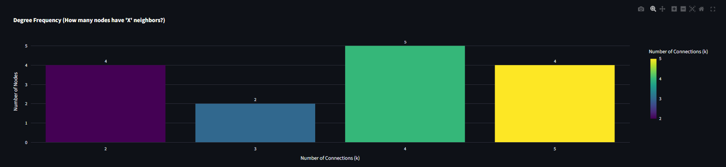
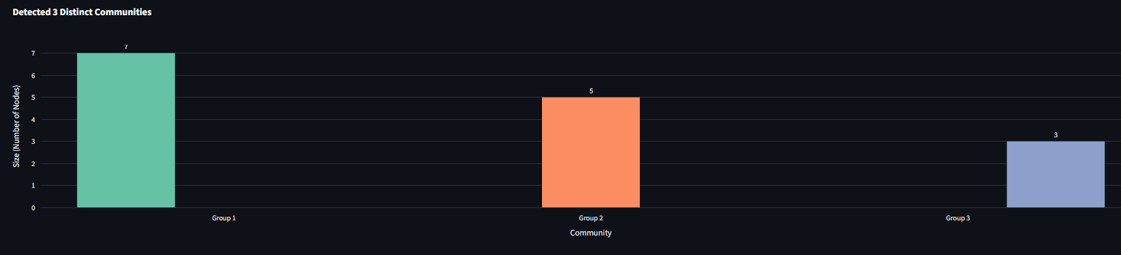
Results & Analysis
Degree Distribution (Erdős-Rényi Sample)
1. Distribution Shift
Moving from Random to Scale-free shifts the bar chart from a bell curve to a power-law — a few nodes have extreme degrees.
2. Degree vs. Betweenness Anomalies
Our scatter plot reveals 'quiet bridges' — nodes with low degree but high betweenness are the most interesting structural actors.
3. Community Detection
Algorithm auto-detected 4 distinct communities in a 14-node Erdős-Rényi graph, with Group 1 containing 6 nodes.
Notes:
9

Slide 12
Challenges
1.Mathematical Edge Cases
Eigenvector centrality failed on disconnected graphs due to non-convergence. We implemented error handling and fallback logic to ensure stability without breaking the dashboard.
2. Graph Rendering Performance
Larger node counts caused layout lag and visual clutter. We optimized physics parameters and controlled re-render triggers to maintain smooth interactivity.
3. State Management in Streamlit
Streamlit’s reactive model caused unnecessary re-computation. Careful use ofst.session_state was required to prevent full graph regeneration on minor UI interactions.
4. Model Interpretation Gap
Translating abstract graph theory (e.g., phase transitions, power laws) into intuitive visuals required multiple redesign iterations.
Notes:
10

Slide 13
Learning Experience
1.Theory Becomes Clear Through Visualization Seeing centrality and topology update in real time deepened our understanding far beyond static textbook examples.
2. Network Structure Drives Behavior The same number of nodes behaves completely differently under Erdős–Rényi, Barabási–Albert, and Watts–Strogatz models.
3. Bridges Matter More Than Popularity Betweenness centrality revealed that influence is structural — not just about having the most connections.
4. Engineering + Mathematics Integration This project strengthened our ability to connect graph theory, Python implementation, and interactive UI design into one cohesive system.
Notes:
10

Slide 14
Conclusions
1.Interactive Learning Transforms Theory into Insight By allowing users to manipulate parameters in real time, abstract graph theory becomes intuitive and visually understandable.
2. Topology Determines Network Behavior Erdős–Rényi, Barabási–Albert, and Watts–Strogatz models produce fundamentally different structures — proving that network growth rules shape real-world outcomes.
3. Influence Is Multi-Dimensional Degree, Betweenness, and Eigenvector centralities measure different types of importance. True influence depends on structural position, not just popularity.
4. Bridging Mathematics and Engineering This project demonstrates how mathematical theory, data science tools, and interactive UI design can integrate to create meaningful analytical systems.
Notes:
10

Slide 15
👥 Team Contributions
Michael Fernandes - UI/UX Design & Streamlit Development
Designed and implemented the interactive graph dashboard
Integrated user-controlled parameters (nodes, probability, model selection)
Implemented centrality computations and real-time visualization
Manav Williams- Presentation Design & Visual Communication
Designed and structured the PowerPoint presentation
Developed visual storytelling framework using Canva
Ensured clarity and logical flow of technical concepts
Anshul Shashidhar - Project Documentation & Report Writing
Authored the detailed project report
Documented methodology, model explanations, and results analysis
Structured technical findings into formal academic format
Notes:
12

